Slide 1
portfolio
Taught by Yossef Ayman Zedan

Slide 2
Navbar
We will take this navbar: https://getbootstrap.com/docs/5.1/components/navbar/#supported-content
Delete the form and keep the rest
Give it fixed-top navbar-dark and style="background-color: rgba(29,224,153,0.8);”
Give ms-auto to the ul

Slide 3

Home Section

Slide 4
Home section
For this section, we use text-center, text-white, container, “row align-items-center” with style="height: 100vh;" so we can align the content according to this height, display-1 and btn-outline-light

Slide 5
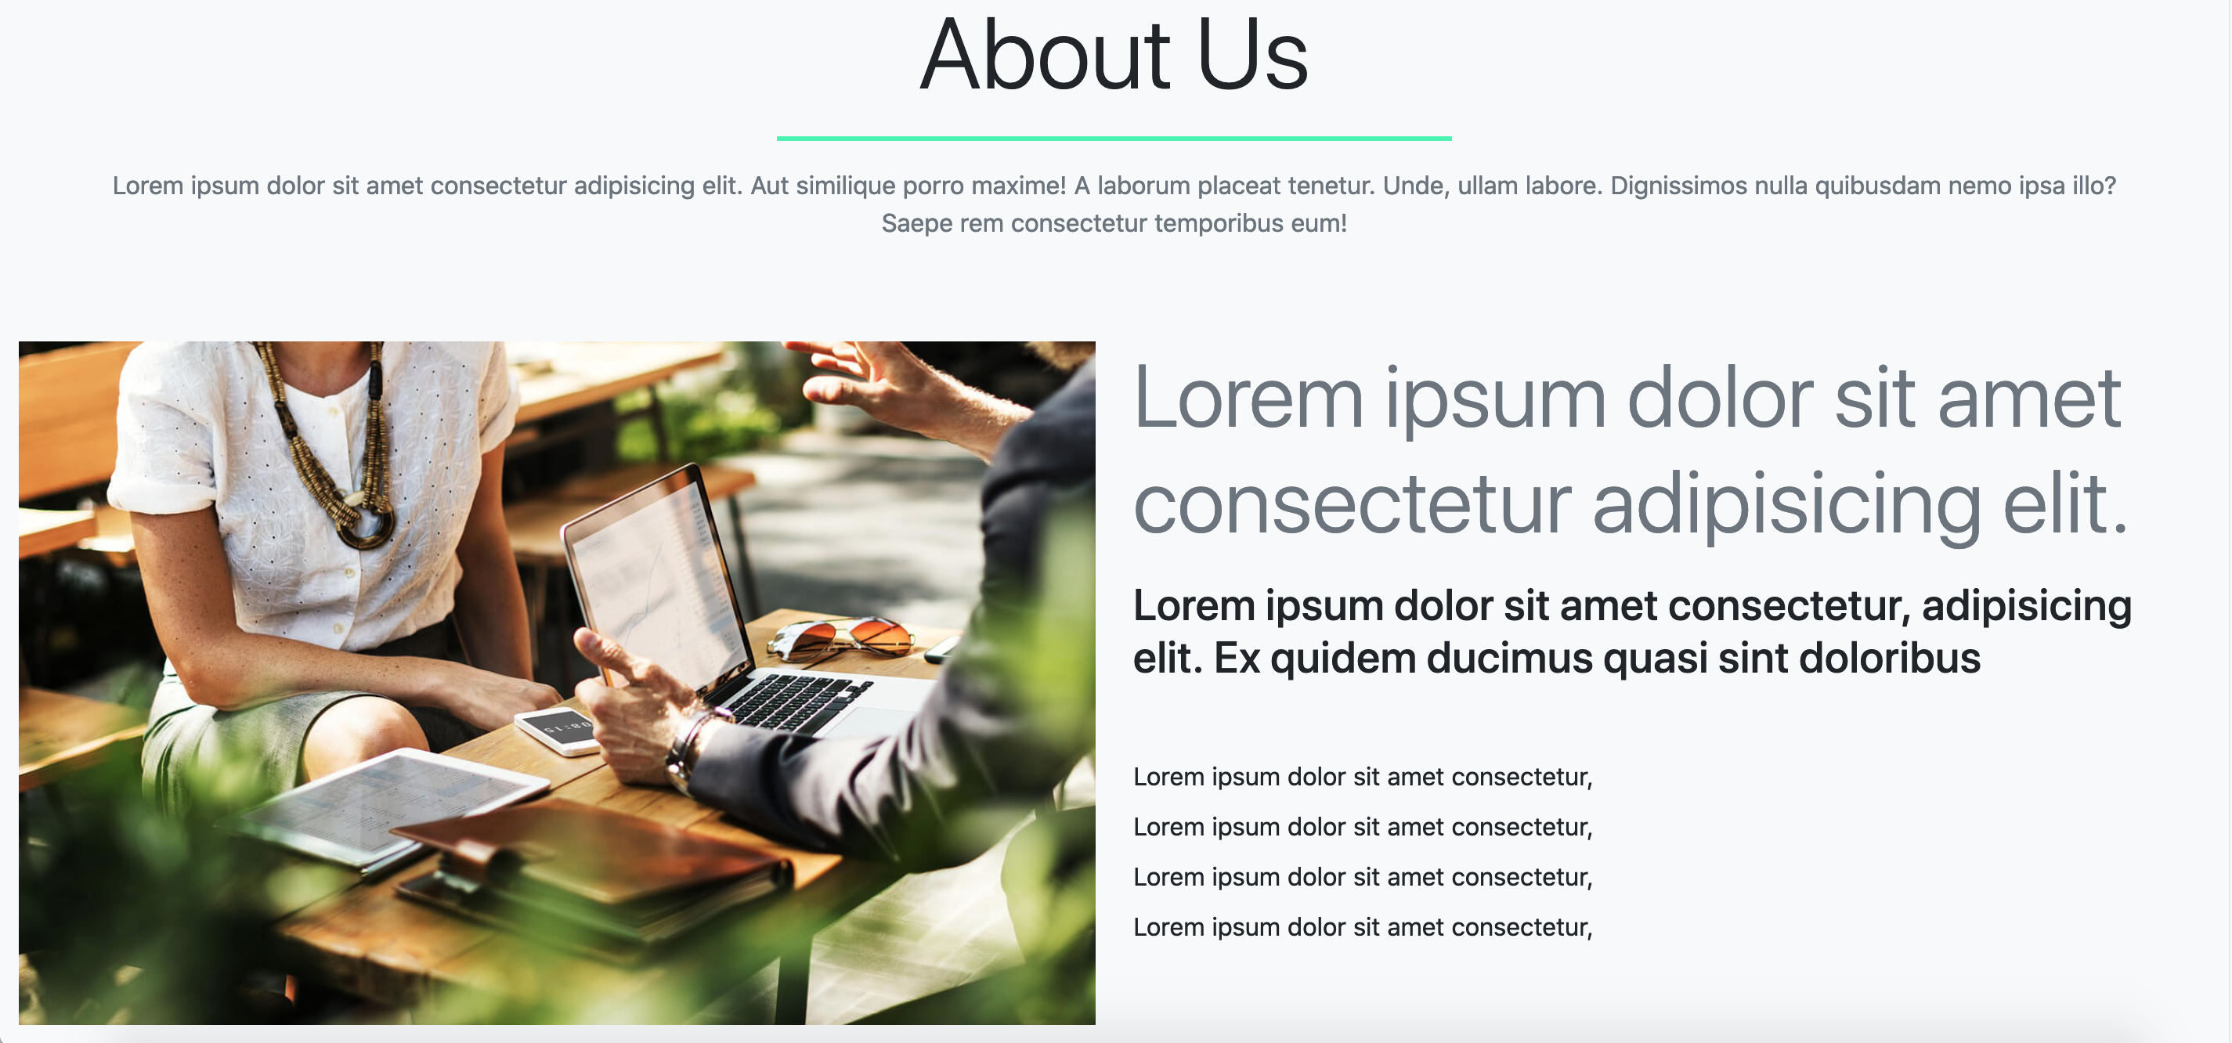
About section

Slide 6
About section
For this section, use use bg-light, py-5 to the section, container, row with text-center
Display-3 for title and then border-danger. For the paragraph it’s text-muted.
Then we use container fluid for the grid system, row with mt-5 and two col-lg-6. The second column will have mt-4 mt-lg-0 to add some margin from less than the large screen.
The second column will contain two headers and a list

Slide 7
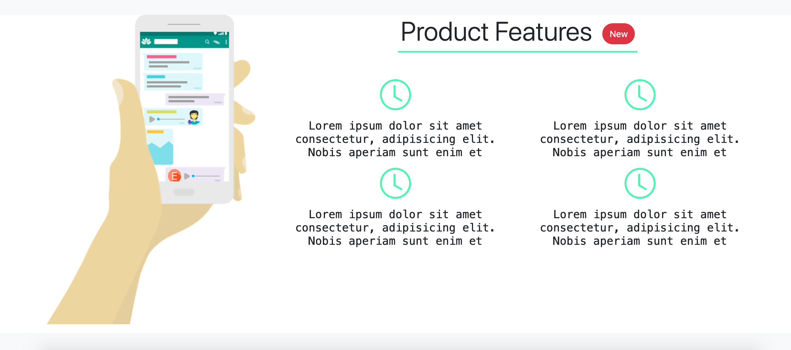
Features

Slide 8
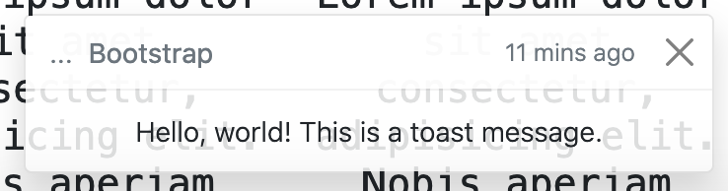
Features
For this section, container, row, col-lg-4 for the image and col-lg-8 for the content.
For the content, we use header and inside it we have a button with a toast.

Slide 9
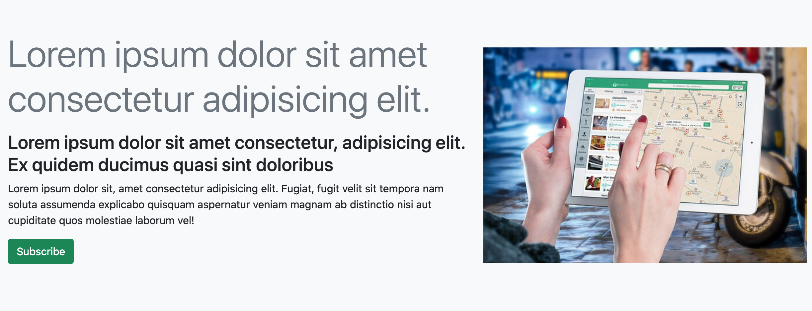
Modal section

Slide 10
Modal section
For this section, we use container-fluid, ” row justify-content-evenly align-items-center”, col-lg-7 for the content and col-lg-5 for the image.
We will take this modal: https://getbootstrap.com/docs/5.1/components/modal/#live-demo
And this validation form: https://getbootstrap.com/docs/5.1/forms/validation/#tooltips

Slide 11
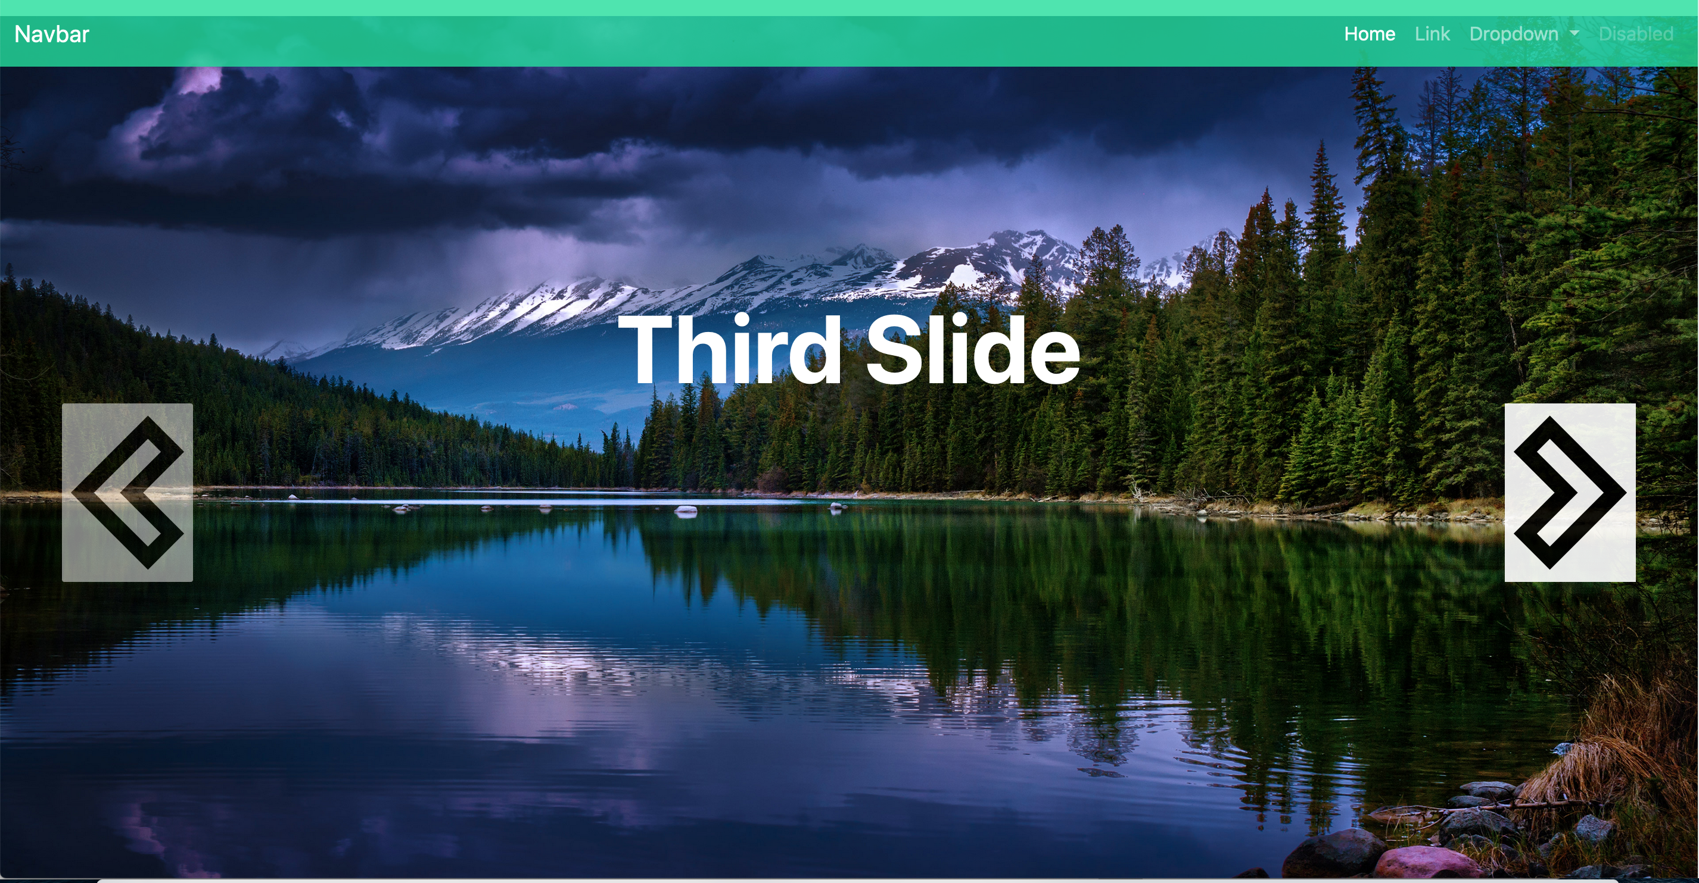
Carousel section

Slide 12
Carousel section
For this section, we use this carousel: https://getbootstrap.com/docs/5.1/components/carousel/#crossfade and add caption with: <div class="carousel-caption d-none"> <h5>First slide label</h5> <p>Some representative placeholder content for the first slide.</p> </div>
And then we add: position-absolute top-50 translate-middle-y to the caption to control its position.

Slide 13
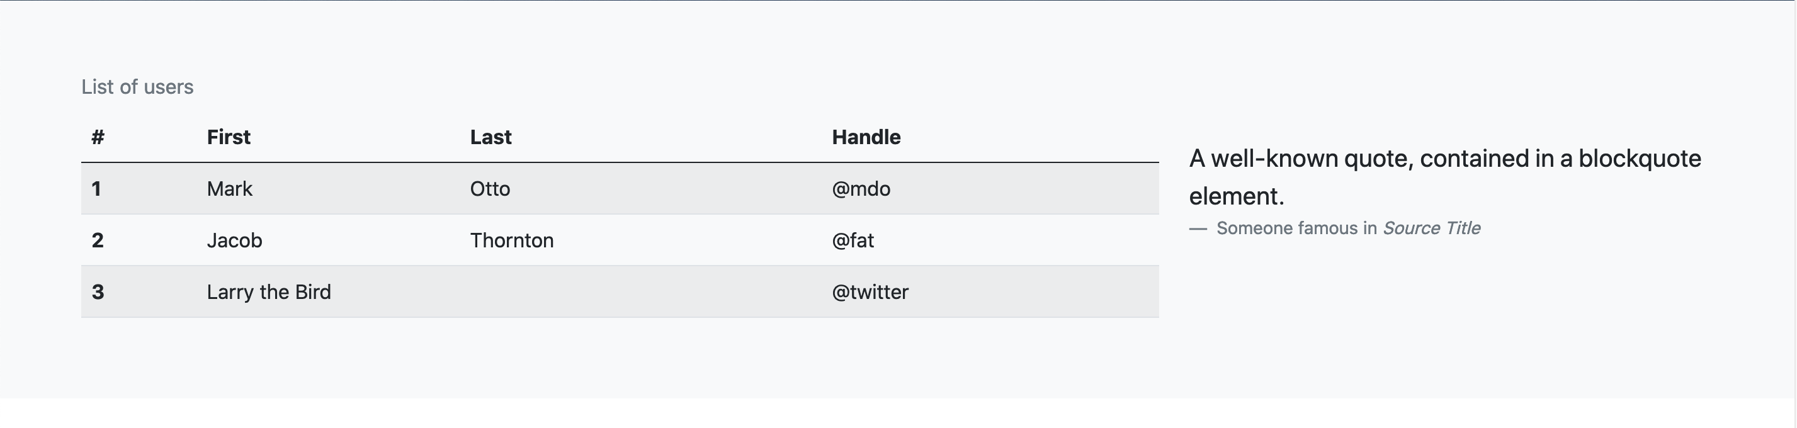
Table section

Slide 14
Table section
For this section, container, “row align-items-center”, col-md-8 for the table and col-md-4 for the figure and blockquote with mt-md-0 mt-5
The table: https://getbootstrap.com/docs/5.1/content/tables/#overview
Don’t forget to add <div class=”table-responsive”> <table></table> </div>
Figure with blockquote: https://getbootstrap.com/docs/5.1/content/typography/#blockquotes

Slide 15
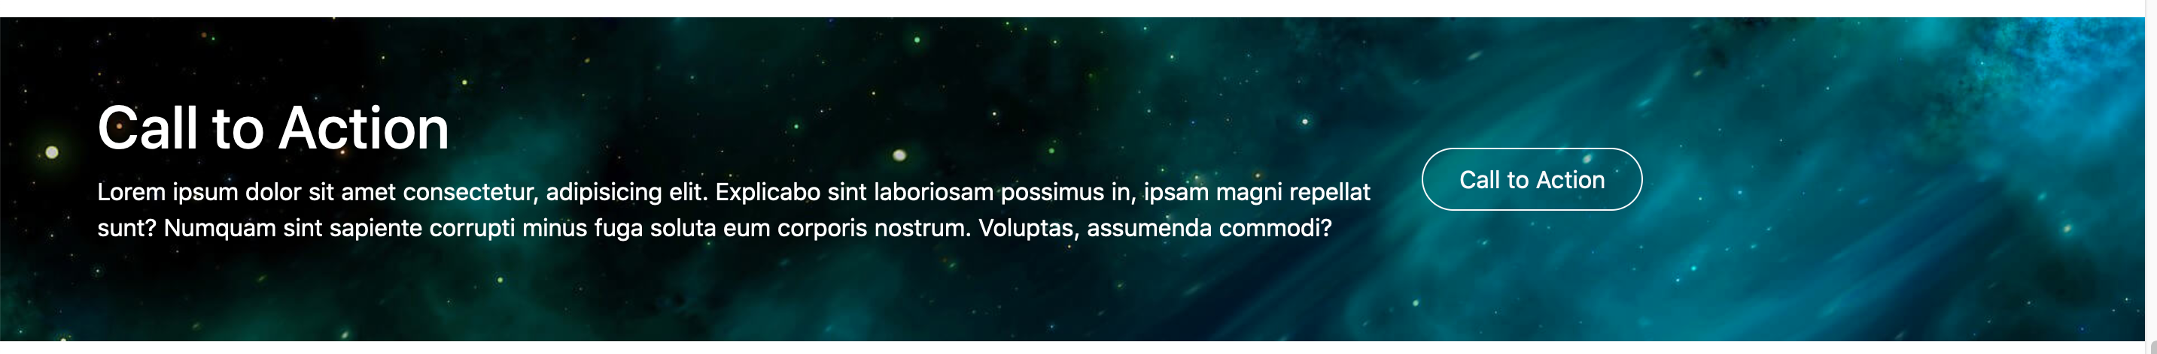
Call to action

Slide 16
Call to action
For this section, container, “row justify-content-center align-items-center”, col-lg-8 for the content and col-lg-4 for the alert:
<div class="alert mt-5 alert-success alert-dismissible fade show" id="successAlert">
<strong>Thank you for calling us</strong>
<button type="button" class="btn-close" data-bs-dismiss="alert"></button>
</div>
<script>
function animation() {
$('#successAlert').slideToggle("slow");
}
})
</script>

Slide 17
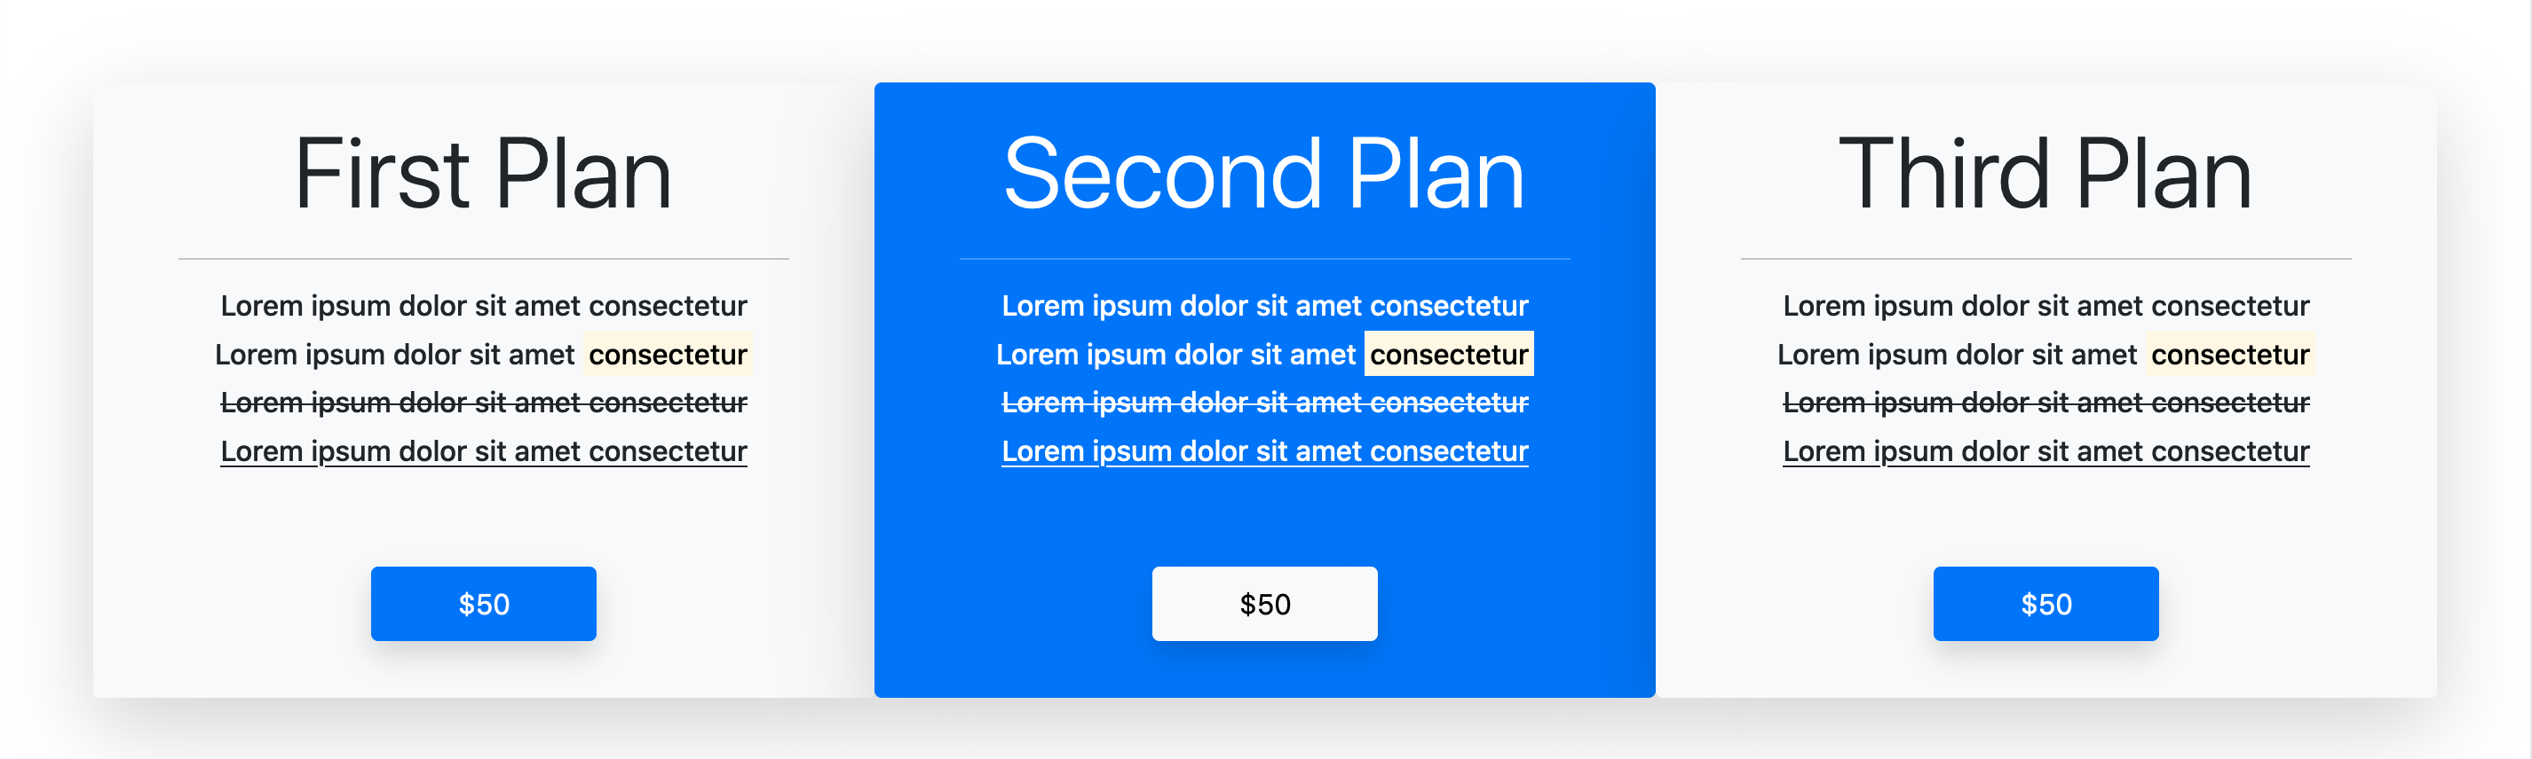
Pricing plans

Slide 18
Pricing plans
For this section, container and 3 “col-md-4 px-5 py-3 bg-light/primary shadow-lg rounded-2” with text-center for the row.
We use some markup like: del, mark and u

Slide 19
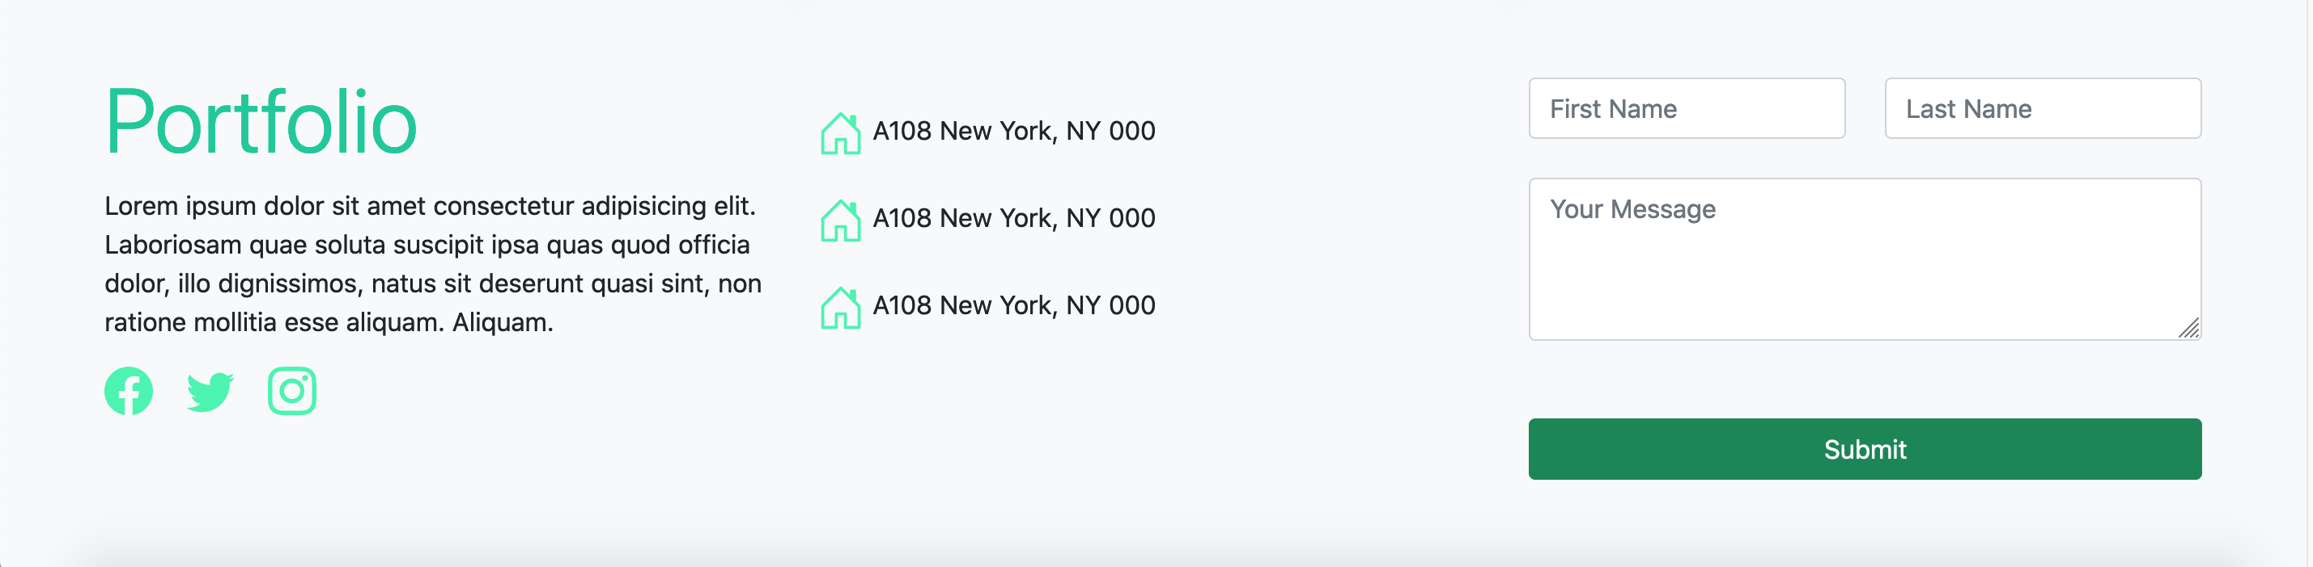
Footer

Slide 20
Footer
For this footer, container, row with align-items-center, three col-lg-4 col-md-6 with mb-5 but the last column doesn’t has col-md-6. It will be taking 100% of the screen.
We add a validation form with the script, form and some content

